Slide 1
Java I/O
Java I/O (Input and Output) is used to process the input and produce the output.
Java uses the concept of a stream to make I/O operation fast.
The java.io package contains all the classes required for input and output operations.
Stream
A stream is a sequence of data.
In Java, a stream is composed of bytes.
It's called a stream because it is like a stream of water that continues to flow.

Slide 2
Default Streams
In Java, 3 streams are created for us automatically. All these streams are attached with the console.
1) System.out: standard output stream
2) System.in: standard input stream
3) System.err: standard error stream
Example:
System.out.println("simple message");
System.err.println("error message");

Slide 3
FileInputStream
Java FileInputStream class obtains input bytes from a file.
It is used for reading byte-oriented data (streams of raw bytes) such as image data, audio, video etc.
You can also read character-stream data.
But, for reading streams of characters, it is recommended to use FileReader class.

Slide 4
Example
import java.io.*;
public class FileIp
{
public static void main(String a[])
{
try
{
FileInputStream fis=new FileInputStream("C:\\Users\\HP\\Desktop\\New Folder\\abc.txt");
int i=0;
while((i=fis.read())!=-1)
{
System.out.print((char)i);
}
fis.close();
}
catch(IOException e)
{
}
try{
FileOutputStream fout=new FileOutputStream("C:\\Users\\HP\\Desktop\\New Folder\\abc1.txt");
String s="Welcome to Working with files";
byte b[]=s.getBytes();//converting string into byte array
fout.write(b);
fout.close();
System.out.println("success...");
}catch(Exception e){System.out.println(e);}
}
}

Slide 5
Reader
Java Reader is an abstract class for reading character streams.
The only methods that a subclass must implement are read() and close().
Example:
import java.io.*;
import java.util.*;
class ReaderExample{
public static void main(String[] args)
{
try {
Reader reader=new FileReader("C:\\Users\\HP\\Desktop\\New Folder\\abc.txt");
int ch;
ch = reader.read();
while(ch!=-1)
{
System.out.print((char) ch);
ch = reader.read();
}
reader.close();
}
catch (Exception e) {
System.out.println(e);
}
}
}

Slide 6
Writer
import java.io.*;
public class WriterExample
{
public static void main(String[] args)
{
try
{
Writer writer = new FileWriter("C:\\Users\\HP\\Desktop\\New Folder\\abc.txt");
String s="Changed content";
writer.write(s);
writer.close();
}
catch (Exception ex)
{
System.out.println(ex.getMessage());
}
}
}

Slide 7
Reading Console Input
Different Ways to read console input:
Using BufferedReader Class
Using Scanner Class
Using Console Class

Slide 8
Using the BufferedReader Class
This is the oldest technique in Java used for reading console input.
This technique was first introduced in JDK 1.0.
Using this technique we need to wrap InputStreamReader and System.in in the BufferedReader class.
Syntax:
BufferedReader br = new BufferedReader (new InputStreamReader (System.in));
Using this will link the character based stream ‘br’ to the console for input through System.in.

Slide 9
BufferedReader Class Example
import java.io.*;
class BufferedReaderEg
{
public static void main(String args[]) throws IOException
{
char ch;
BufferedReader br = new BufferedReader(new InputStreamReader (System.in));
System.out.println ("Enter input");
int i=br.read();
System.out.print((char)i);
//For reading a String
String s;
s=br.readLine();
System.out.println(s);
}
}

Slide 10
Using Scanner Class
The Scanner class was introduced in JDK 1.5 and it has been widely used thereof.
The Scanner class provides various methods for easing the way we get input from the console.
Scanner class is defined in java.util so you need to import this first.
Syntax:
Scanner obj_name = new Scanner (System.in);

Slide 11
Scanner Class Example
import java.util.*;
class ScannerEg
{
public static void main(String args[])
{
Scanner sc = new Scanner (System.in);
int no1,no2,tot;
System.out.println ("Enter integer1");
no1=sc.nextInt();
System.out.println ("Enter integer2");
no2=sc.nextInt();
System.out.println(no1+no2);
}
}

Slide 12
Using Console Class
This is another way of reading user input from the console in Java.
This way of reading user input has been introduced in JDK 1.6.
This technique also uses System.in for reading the input.

Slide 13
Console Class Example
import java.io.*;
class ConsoleEg
{
public static void main(String args[])
{
String name;
System.out.println ("Enter your name: ");
Console c = System.console();
name = c.readLine();
System.out.println ("Your name is: " + name);
}
}

Slide 14
Writing output to console
The methods used for streaming output are defined in the PrintStream class.
The methods used for writing console output are print(), println() and write().
Both print() and println() methods are used to direct the output to the console.
These methods are defined in the PrintStream class and are widely used.
Both these methods are used with the help of the System.out stream
Example:
System.out.print(“HI”);//prints in same line
System.out.println(“HI”);//prints in new line

Slide 15
write() method Example
Alternatively, you can make use of the write() method for directing the output of your program to the console
class writeEg
{
public static void main(String args[])
{
int a, b;
a = 'Q';
b = 65;
System.out.write(a);
System.out.write('\n');
System.out.write(b);
System.out.write('\n');
}
}

Slide 16
PrintWriter class
PrintWriter is one of the character-based classes
It is the implementation of Writer class
Example:
import java.io.*;
public class PrintWriterDemo
{
public static void main(String a[])
{
PrintWriter pw=new PrintWriter(System.out,true);
pw.println(“This is a string”);
int i=-7;
pw.println(i);
}
}

Slide 17
write() method Example
Alternatively, you can make use of the write() method for directing the output of your program to the console
class writeEg
{
public static void main(String args[])
{
int a, b;
a = 'Q';
b = 65;
System.out.write(a);
System.out.write('\n');
System.out.write(b);
System.out.write('\n');
}
}

Slide 18
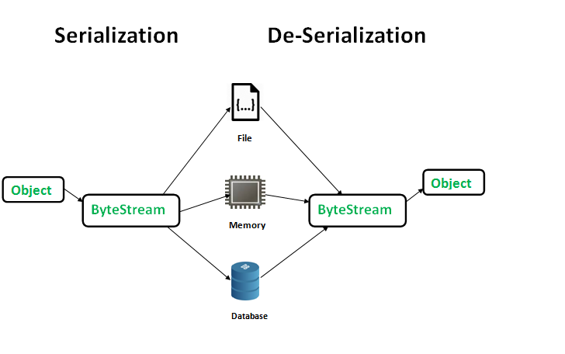
Object Streams and Serialization
Serialization in Java is a mechanism of writing the state of an object into a byte-stream.
For serializing the object, we call the writeObject() method of ObjectOutputStream class
The Serializable interface must be implemented by the class whose object needs to be persisted.

Slide 19
Deserialization
Deserialization is the process of reconstructing the object from the serialized state.
It is the reverse operation of serialization.

Slide 20
Example
import java.io.*;
class Demo implements Serializable
{
public int a;
public String b;
public Demo(int a, String b) {
this.a = a;
this.b = b;
}
}
class ObjSerializeMain{
public static void main(String[] args) {
Demo object = new Demo(1, "Demo class");
String filename = "file.ser";
try
{
FileOutputStream file = new FileOutputStream(filename);
ObjectOutputStream out = new ObjectOutputStream(file);
out.writeObject(object);
out.close();
file.close();
System.out.println("Object has been serialized");
}
catch(IOException ex) {
System.out.println("IOException is caught");
}
Demo object1 = null;
try
{
FileInputStream file = new FileInputStream(filename);
ObjectInputStream in = new ObjectInputStream(file);
object1 = (Demo)in.readObject();
in.close();
file.close();
System.out.println("Object has been deserialized ");
System.out.println("a = " + object1.a);
System.out.println("b = " + object1.b);
}
catch(IOException ex)
{
System.out.println("IOException is caught");
}
catch(ClassNotFoundException ex)
{
System.out.println("ClassNotFoundException is caught");
}
}
}

Slide 21
More about Serialization
When a class implements the Serializable interface, all its sub-classes are serializable as well
But when an object has a reference to another object, these objects must implement the Serializable interface separately, failing which will result in error
The Transient and Static Fields Do Not Get Serialized
If we want to serialize one object but do not want to serialize specific fields, then we can mark those fields as transient.
All the static fields belong to the class instead of the object, and the serialization process serializes the object so static fields can not be serialized.

